Slide 1

A Project Review Meeting on Bank Customer 360 – CRM View
By
Name: Fathima Qhibtiya Khader roll no: 2520030155
Name: Datla Sri Sai Purna Mahija roll no: 2520030261
Team Number: 7
Under the guidance of
Dr. Nirmalajyothi
Associate Professor
Department of Computer Science and Engineering
Koneru Lakshmaiah Education Foundation (Deemed to be University estd. u/s. 3 of the UGC Act, 1956) Off-Campus: Bachupally-Gandimaisamma Road, Bowrampet, Hyderabad, Telangana - 500 043. Phone No: 7815926816, www.klh.edu.in

Slide 2
Outline of the Presentation
Abstract
Introduction
Problem Statement
Project Flow Diagram
Objectives with Justification
Modules[Frontend web pages]
Expected Outcomes of the Proposed Work
Conclusion
References

Slide 3
Abstract
Modern banks store customer information across multiple systems such as account management, loans, KYC records, service requests, and investment platforms. Relationship Managers (RMs) spend significant time switching between these systems, resulting in reduced productivity and poor customer experience.
The Bank Customer 360 CRM View is a unified web-based dashboard that combines all customer-related information into a single interface. The system provides customer profiles, products held, service requests, interaction history, KYC information, audit trails, and intelligent product recommendations through the Next Best Action (NBA) module.
The project improves RM efficiency, enhances customer satisfaction, increases cross-selling opportunities, and supports better decision-making using real-time customer insights.

Slide 4
Introduction
Customer Relationship Management (CRM) plays a crucial role in modern banking.
Current Challenges:
Customer data exists in multiple systems.
Relationship managers spend time searching for information.
Service requests are difficult to track.
Cross-selling opportunities are often missed.
Customer service becomes inconsistent.
Proposed Solution:
Develop a 360-degree customer view.
Provide a centralized dashboard.
Enable faster access to customer information.
Improve customer engagement and operational efficiency.

Slide 5
Problem Statement
In banking organizations, customer information is scattered across various legacy applications.
This leads to:
Increased operational complexity.
Delayed customer service.
Lack of personalized recommendations.
Poor visibility of customer interactions.
Reduced relationship manager productivity.
There is a need for a centralized CRM system that integrates customer data, service history, products, and recommendations into a single platform.

Slide 6
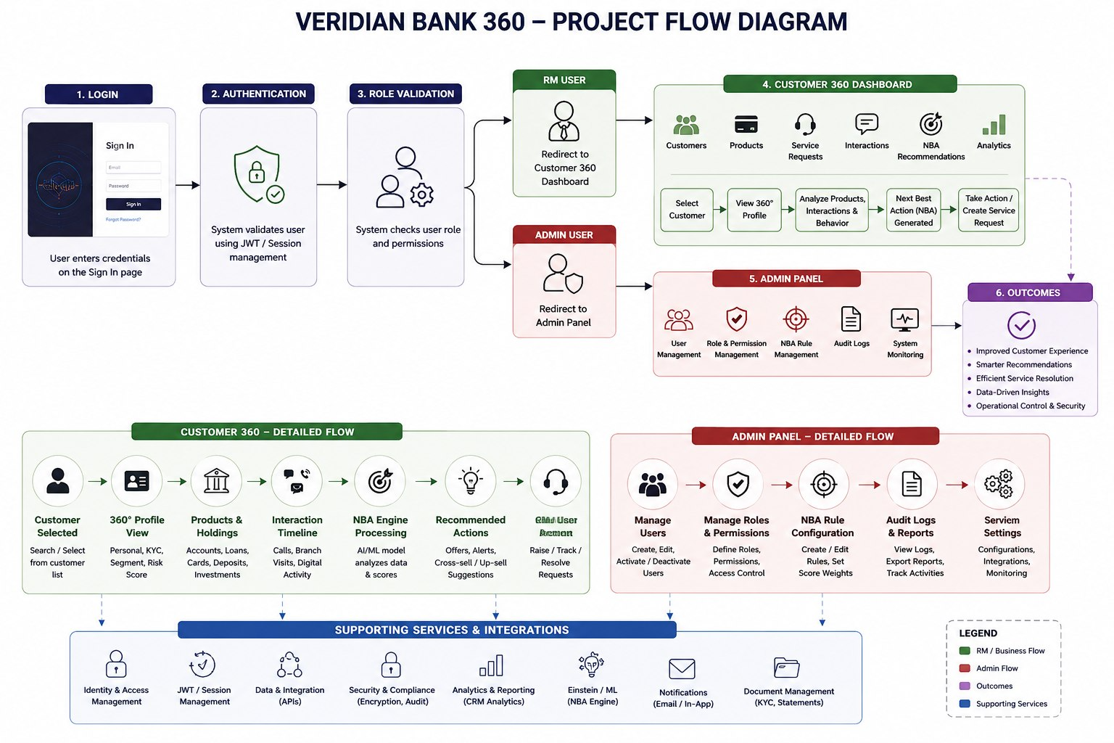
Project Flow Diagram

Slide 7
Objectives with Justification
Objective 1
Provide a unified customer dashboard.
Justification Reduces time spent switching between systems.
Objective 2
Track customer interactions and service requests.
Justification Improves customer service quality.
Objective 3
Provide Next Best Action recommendations.
Justification Supports cross-selling and upselling.
Objective 4
Maintain customer profile and KYC information.
Justification Ensures compliance and accuracy.
Objective 5
Generate reports and audit trails.
Justification Improves transparency and monitoring.

Slide 8
Modules [Frontend web pages]
1. Customer Summary
Displays customer details, segment, risk level, and relationship value.
2. Products Held
Shows accounts, loans, deposits, insurance, and investments.
3. Interaction Log
Tracks branch visits, calls, emails, and customer activities.
4. Note Add
Allows relationship managers to add notes and reminders.
5. Export
Exports customer information to PDF and Excel.
6. Service Requests
Displays ticket status and complaint tracking.
7. NBA Display
Provides intelligent product recommendations.
8. Profile & KYC View
Shows customer profile and KYC verification status.
9. History & Audit Trail
Maintains records of all updates and modifications.
10. Admin Panel & RBAC
Provides role-based access and user management.

Slide 9
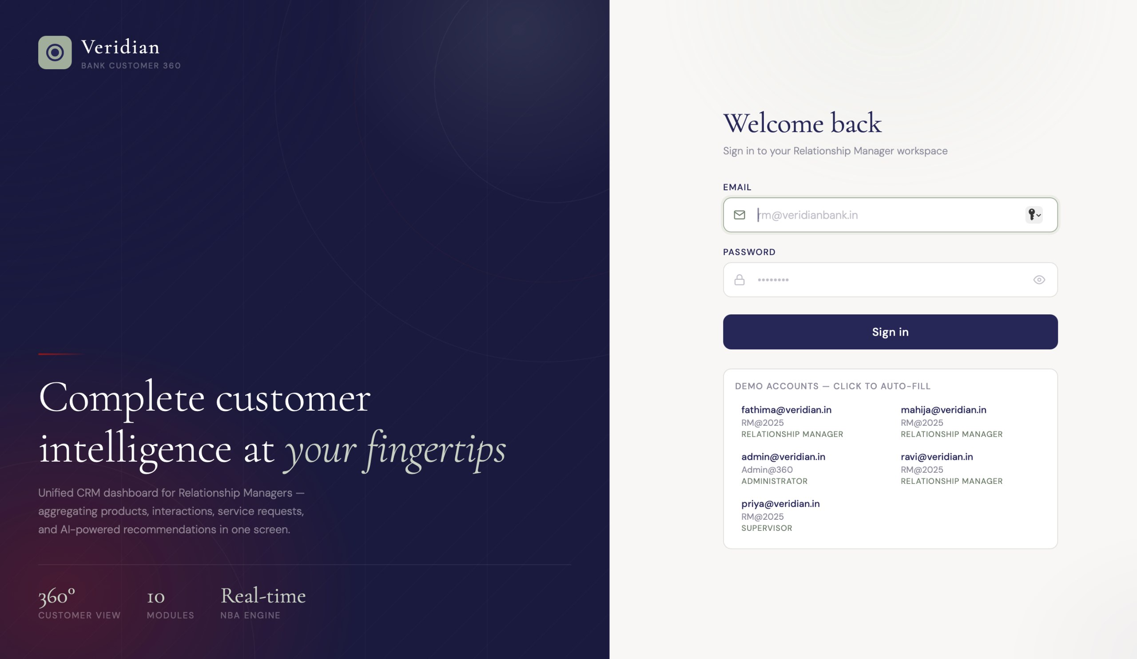
Expected Outcomes of the Proposed Work

Slide 10
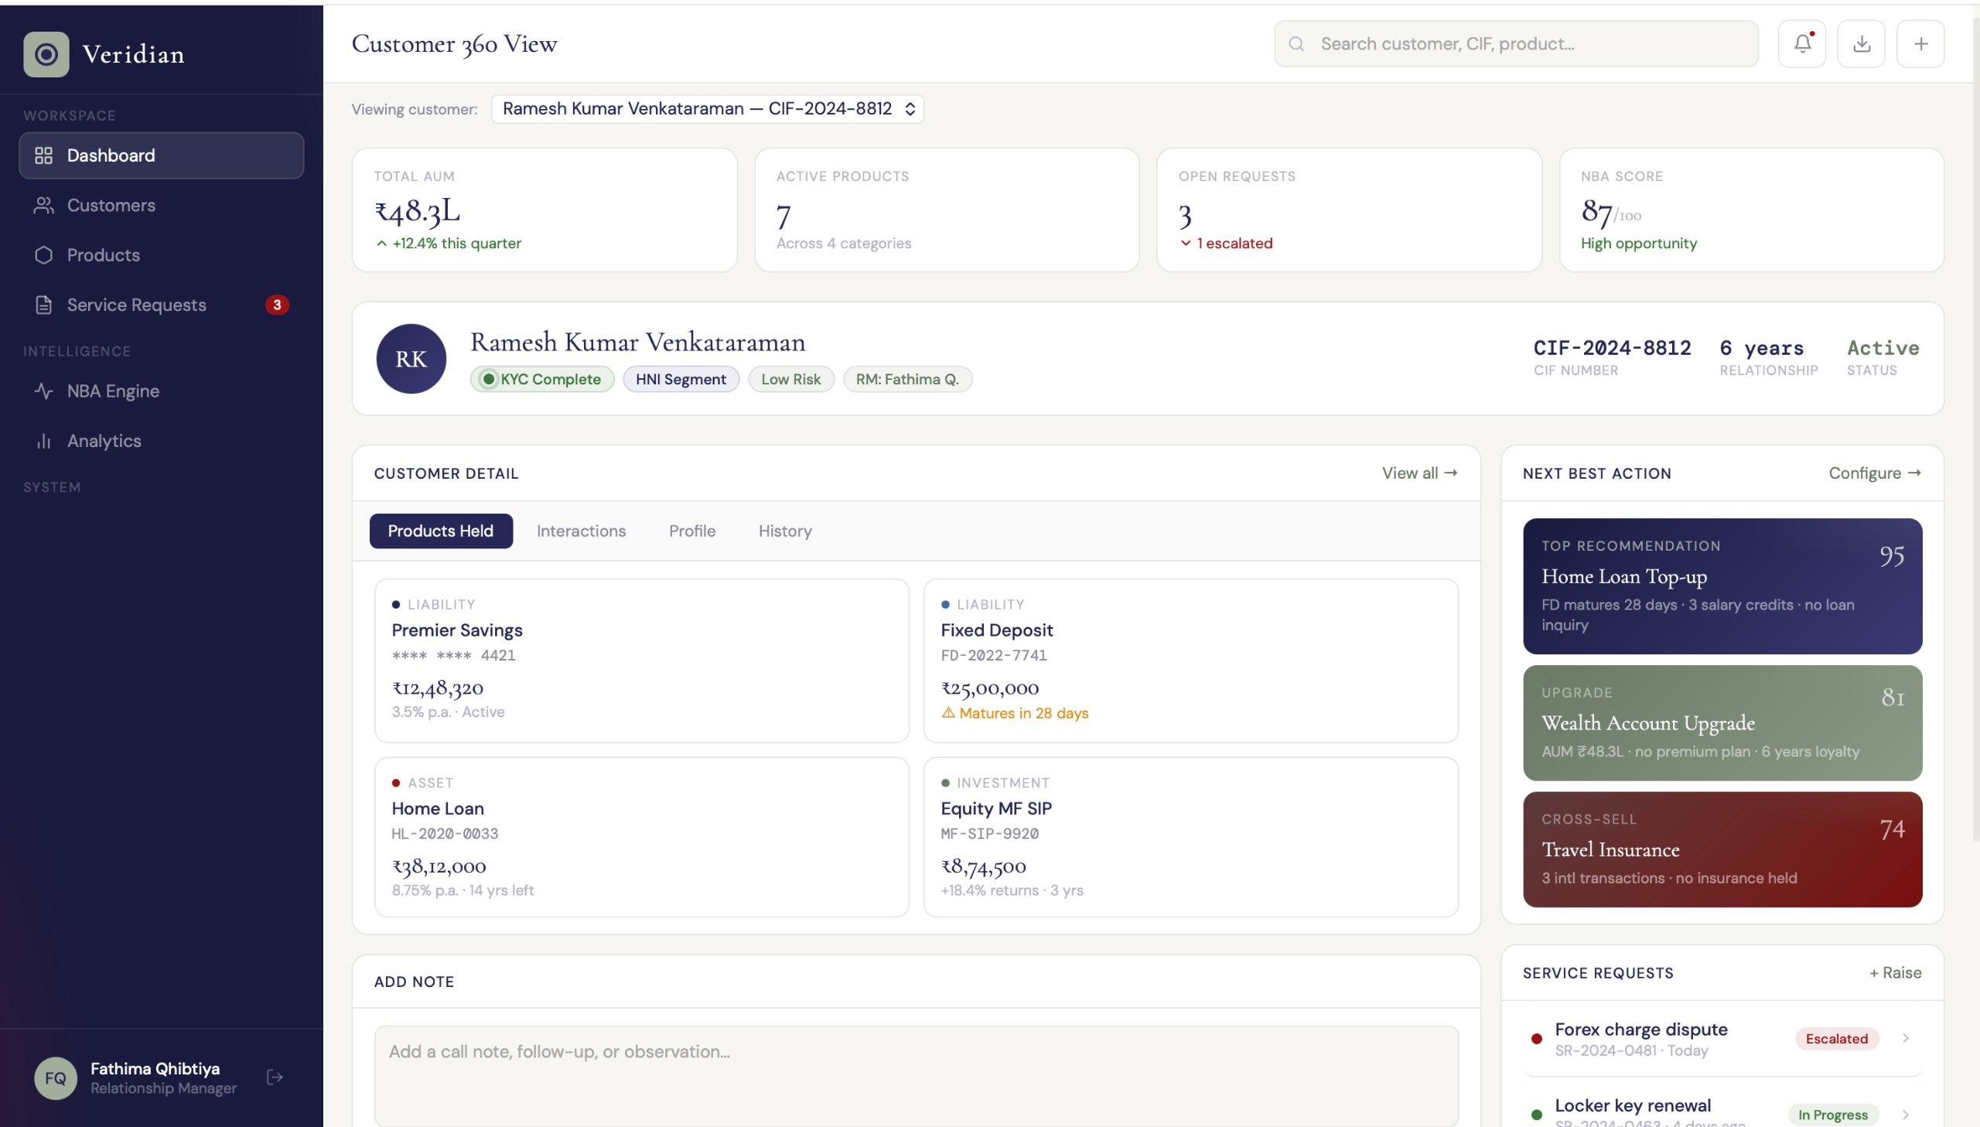
Expected Outcomes of the Proposed Work

Slide 11
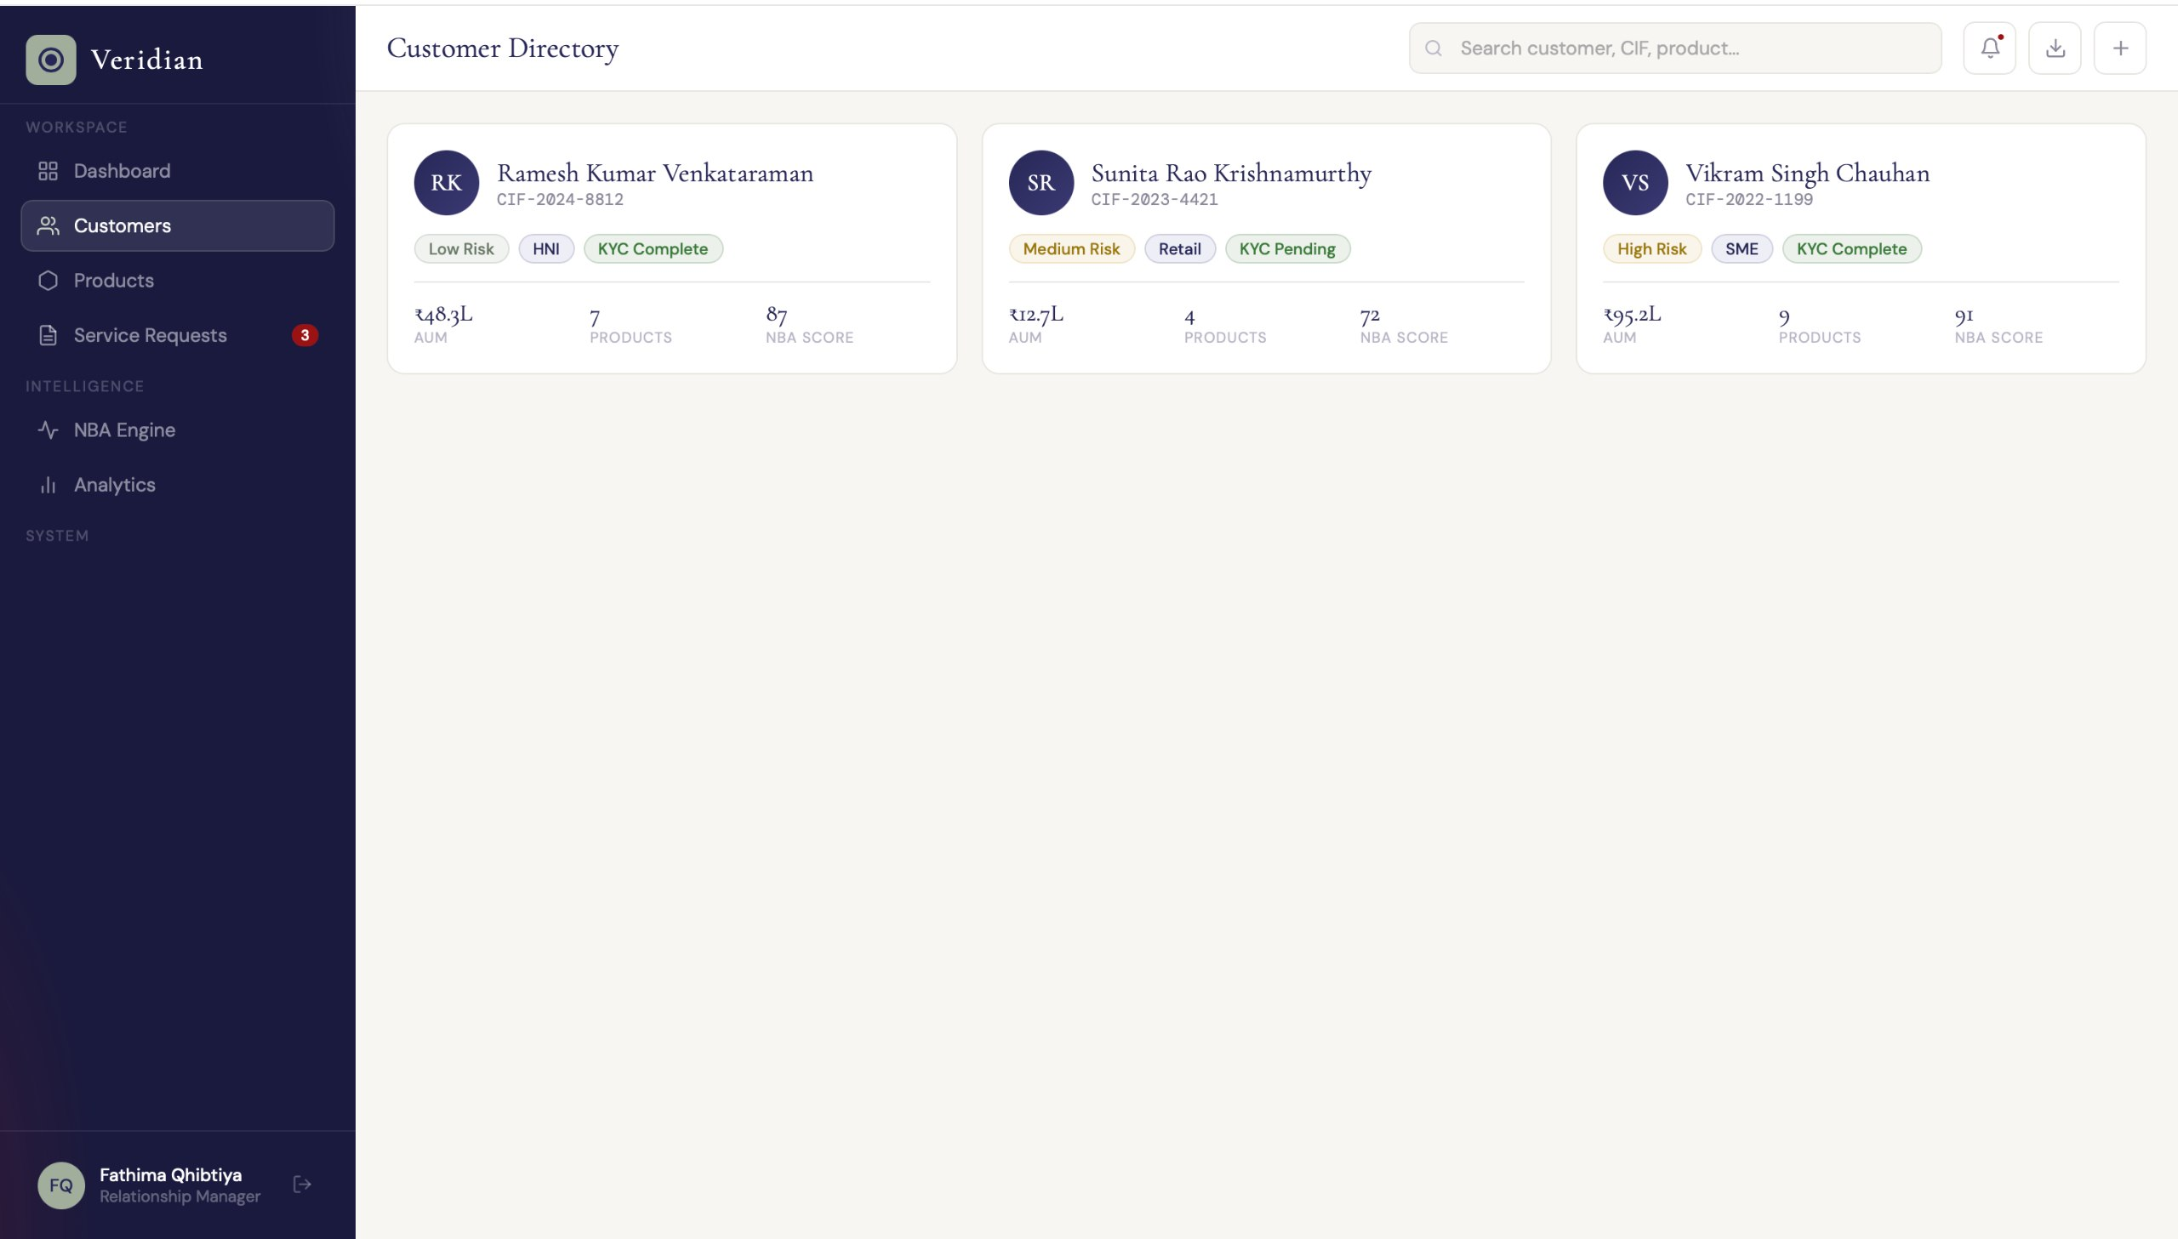
Expected Outcomes of the Proposed Work

Slide 12
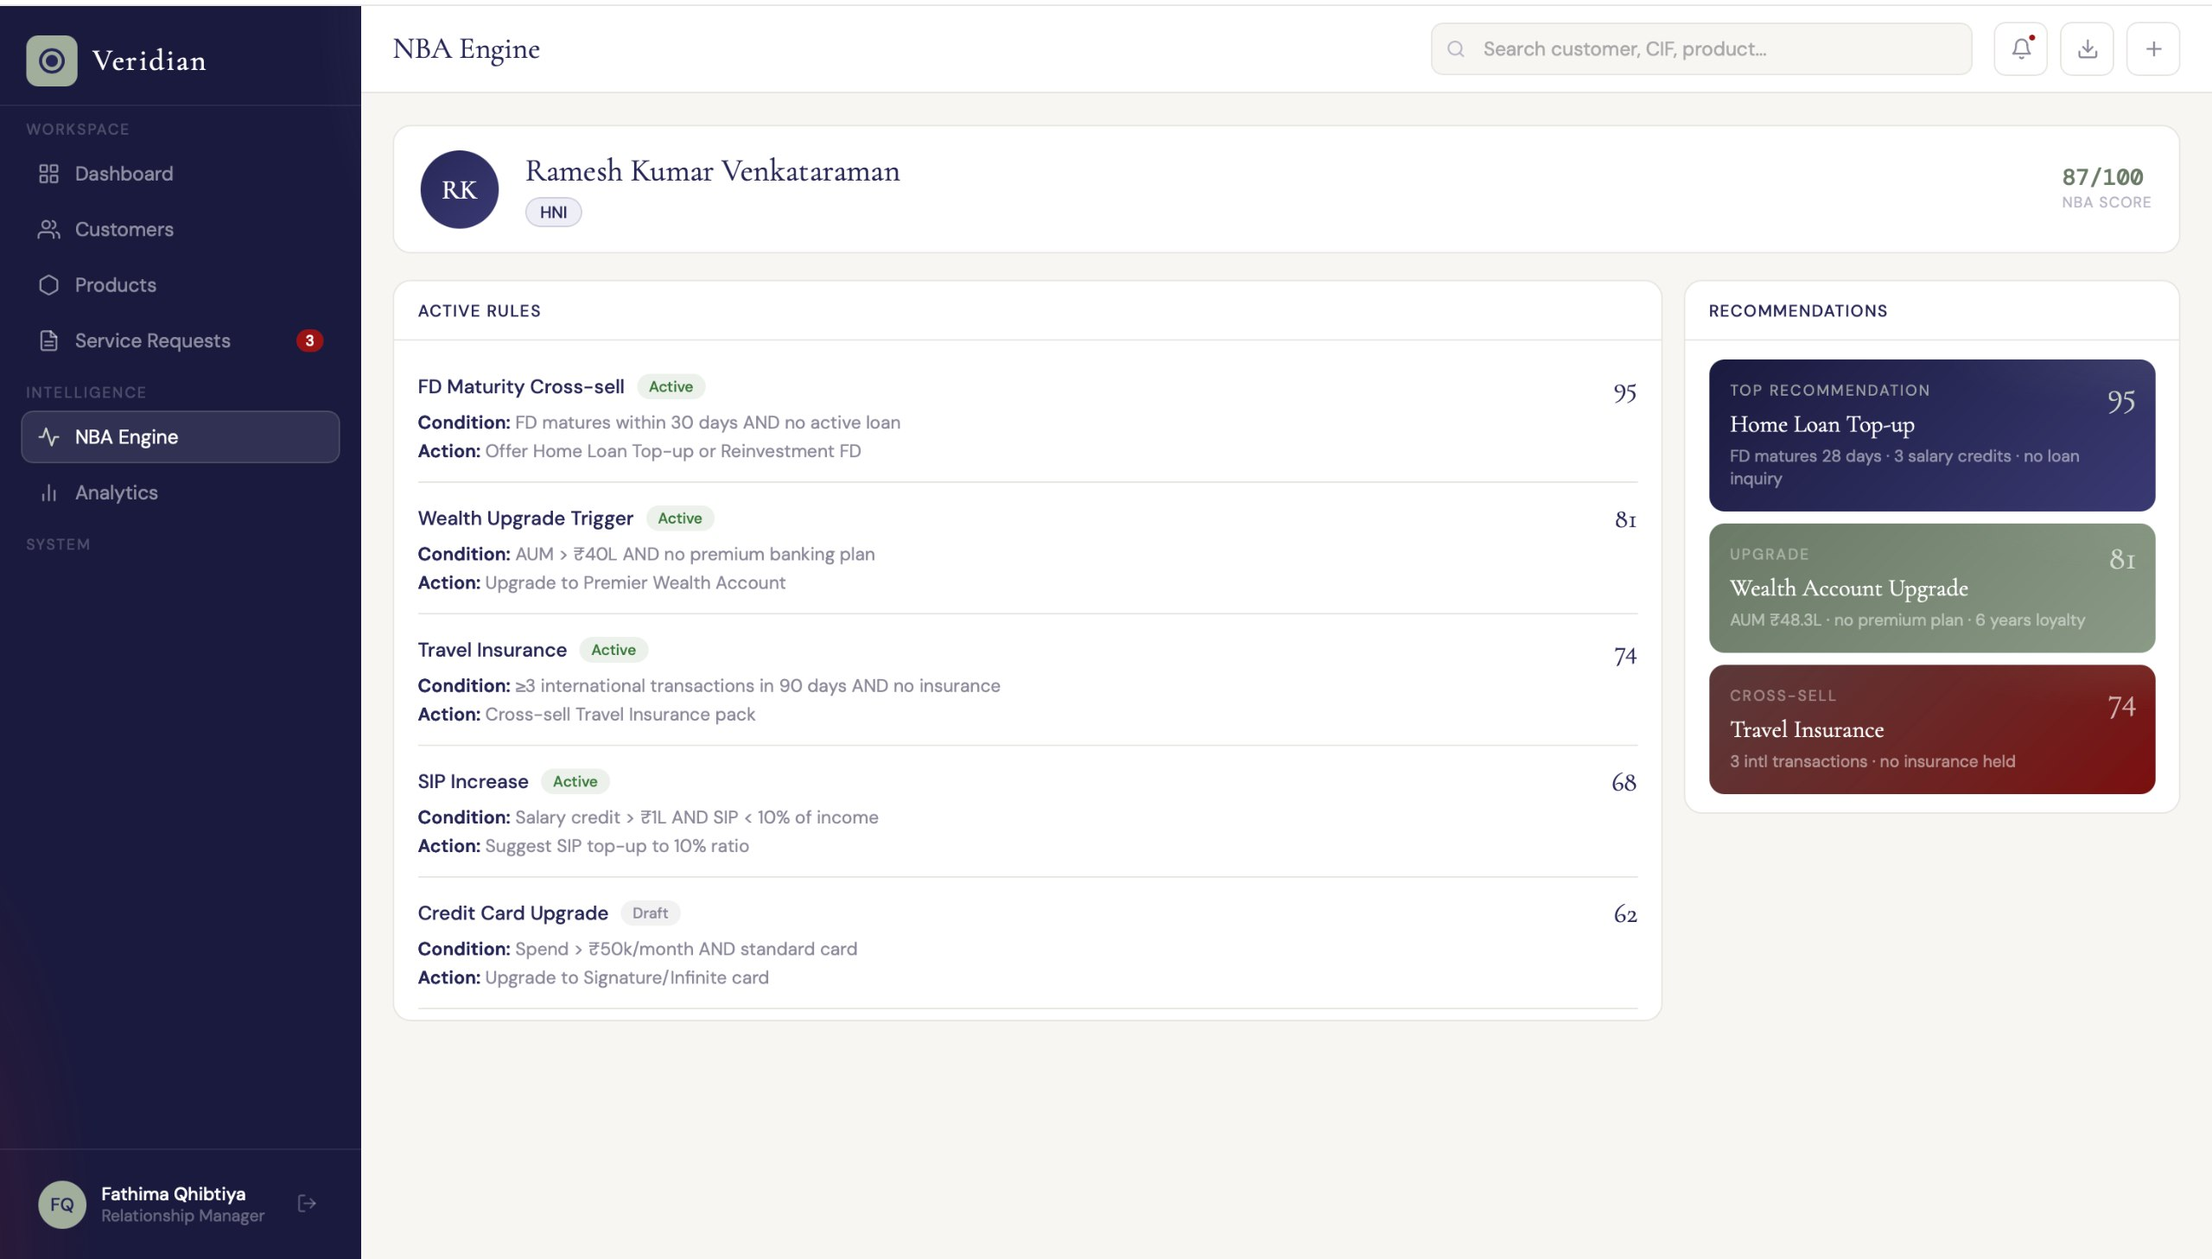
Expected Outcomes of the Proposed Work

Slide 13
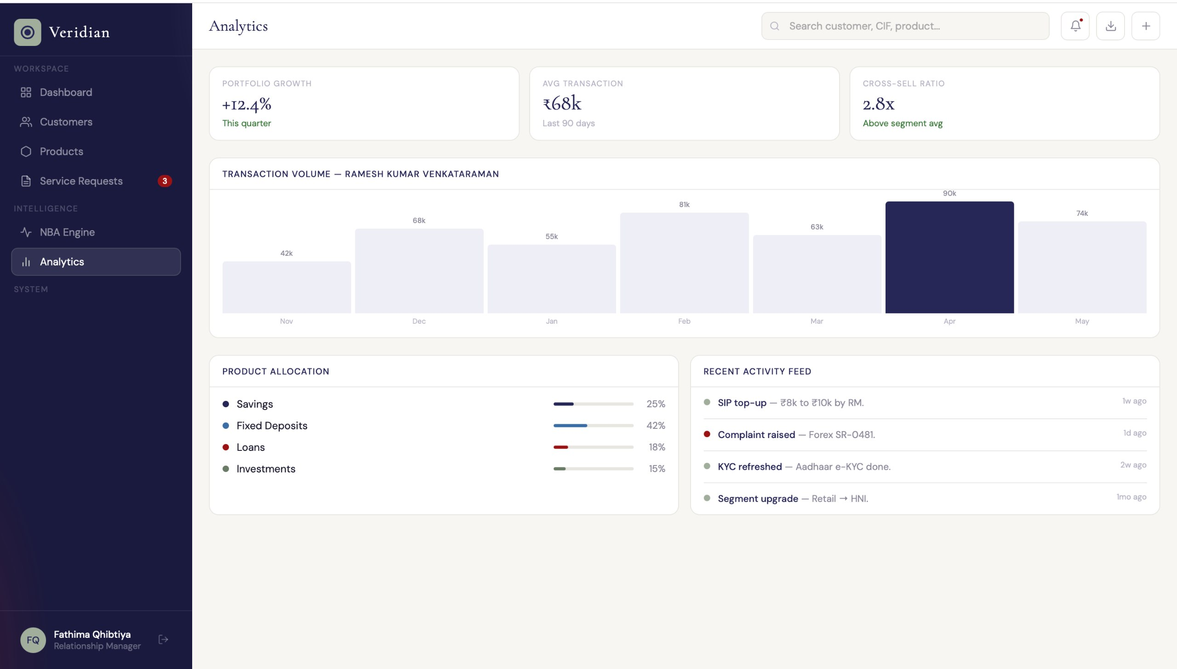

Slide 14
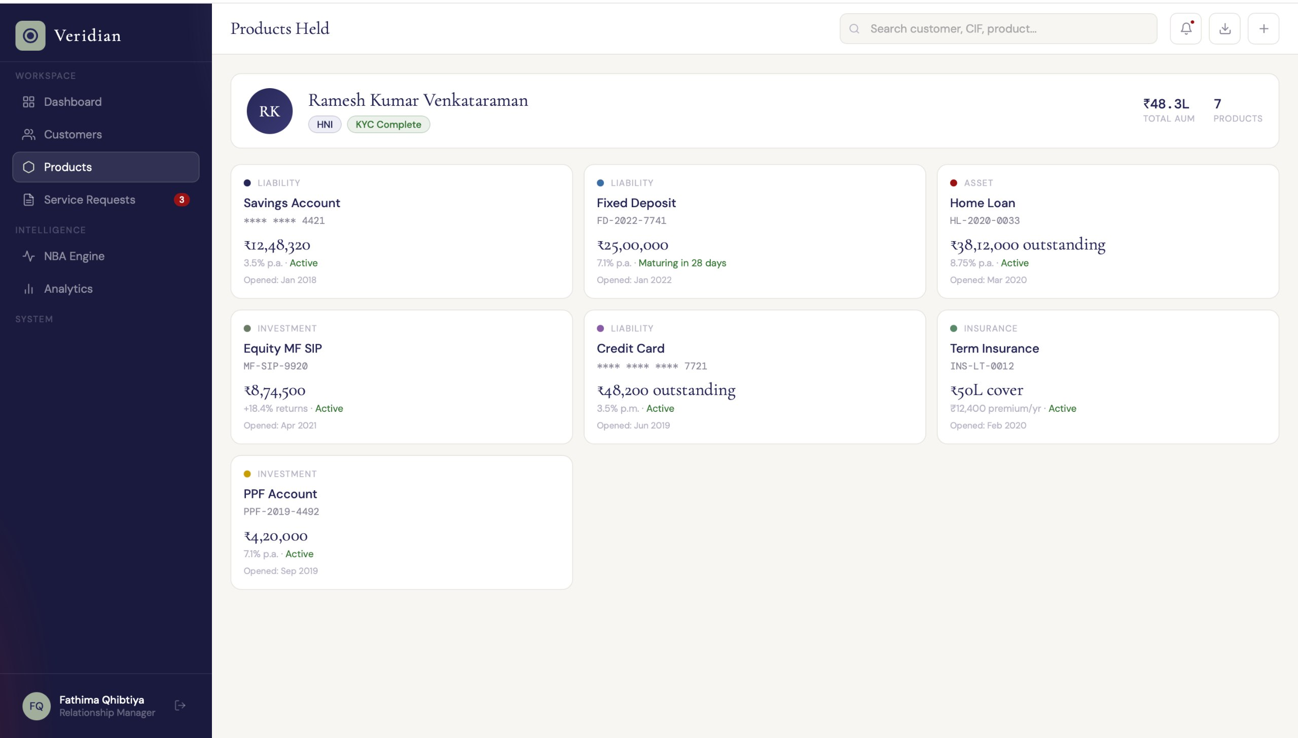

Slide 15
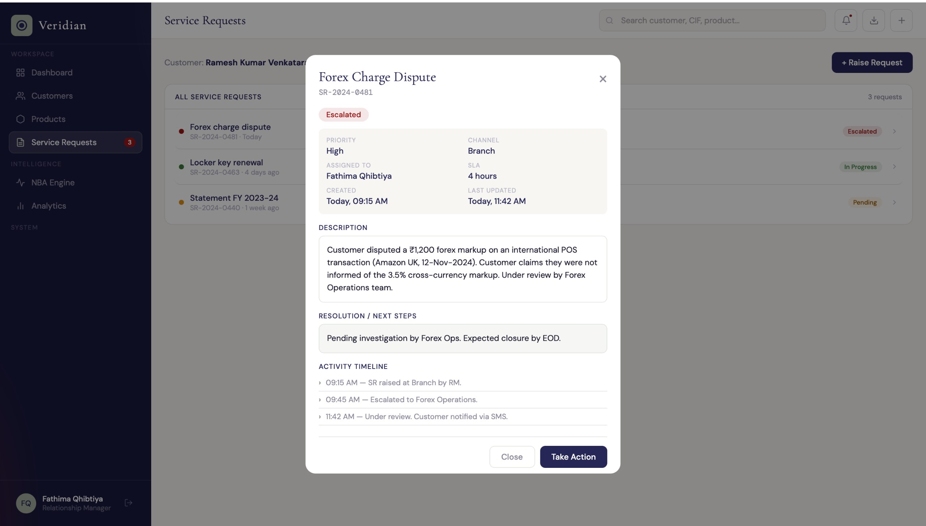

Slide 16
Conclusion and Future Scope
The Bank Customer 360 CRM View provides a complete customer overview through a centralized dashboard. It simplifies customer management, improves relationship manager efficiency, and enhances customer experience.
Future Scope
AI/ML-based recommendation engine.
Predictive customer analytics.
Mobile CRM application.
Real-time notification system.
Integration with advanced banking platforms.
Customer sentiment analysis.

Slide 17
References
https://www.salesforce.com/financial-services/cloud/crm/
https://www.zoho.com/crm/verticals/financial-services/

Slide 18
Thank you

